Slide 1
Geocart :A Comprehensive Retail Sales Analysis and Business Insights
Presenters:
Vemulamada Hema Sree
Rajveer Dhankani
Saireddy Teja Reddy
Ayan Dhara
Molugu Sai Vaishnavi

Slide 2




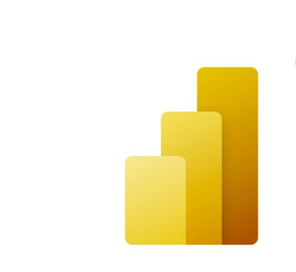

Problem Statement
The project centers around Geocart, a growing e-commerce platform aiming to optimize user experience and business performance through deep analysis of retail sales data. By leveraging cloud-native Azure services, this project establishes a scalable, maintainable, and high-performance data pipeline to enable seamless data ingestion, transformation, and advanced analytics. This cloud-driven approach allows Geocart to extract actionable insights, enhance customer engagement, and refine operations.
Services Used:
Azure Databricks
Azure Data Factory
Azure Data Lake Storage Gen 2
Key Vault
Power BI
Logic Apps

Slide 3

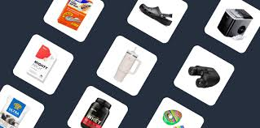

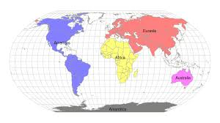

Datasets Used
Customers.csv
Personal details of the customer.
Key Columns: CustomerID, Name, Phone Age, AnnualIncome
Products.csv
Details and Types of the products.
Key Columns: ProductID, ProductName, Category, UnitPrice
Transactions.csv
Transaction details of customers purchase.
Key Columns: TransactionID, Date, TotalAmount, PaymentType
Regions.json
Details of different regions around the world.
Key Columns: RegionID, RegionName, ManagerName
Support_tickets.jsonTickets raised by customers.
Key Columns: TicketID, AgentName, SLABreached, Tags

Slide 4
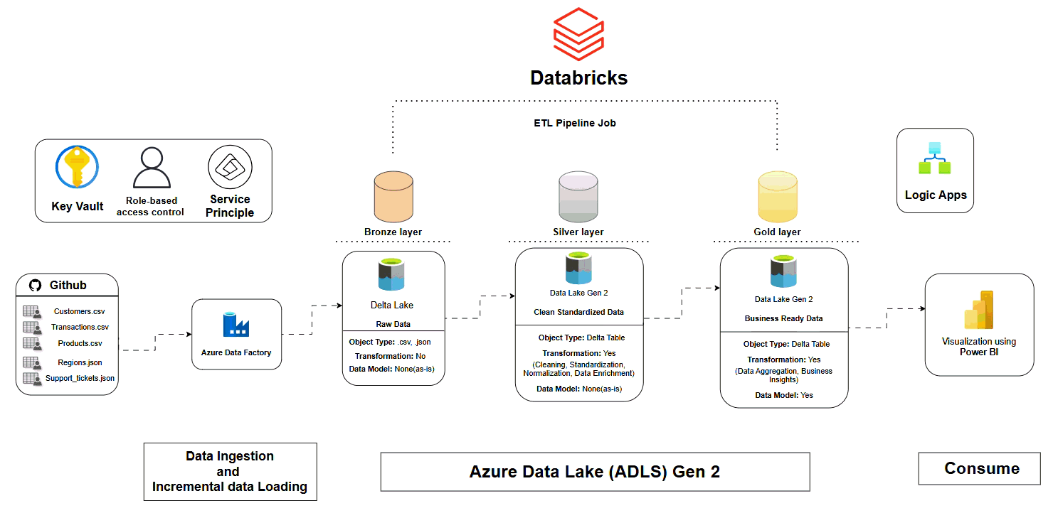
Architecture

Slide 5
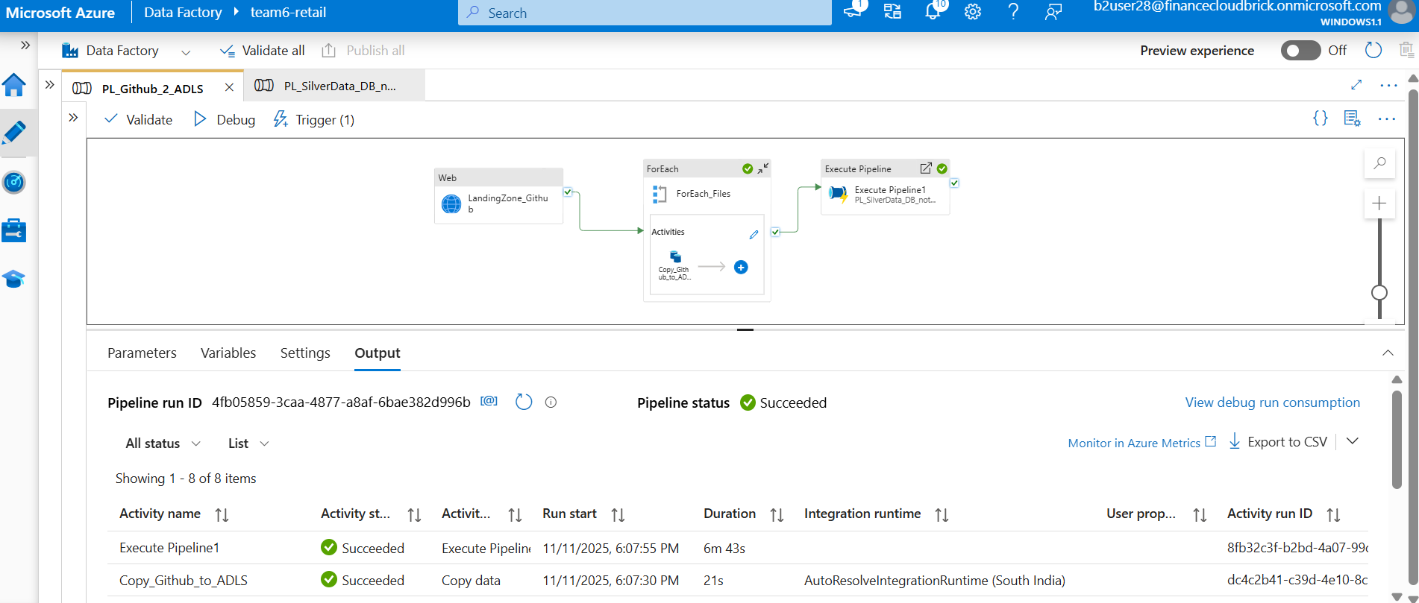
Data Ingestion
Fetched datasets from GitHub repository.
Designed and deployed an ETL pipeline using Azure Data Factory to automate data transfer from GitHub to Azure Data Lake Storage.

Slide 6
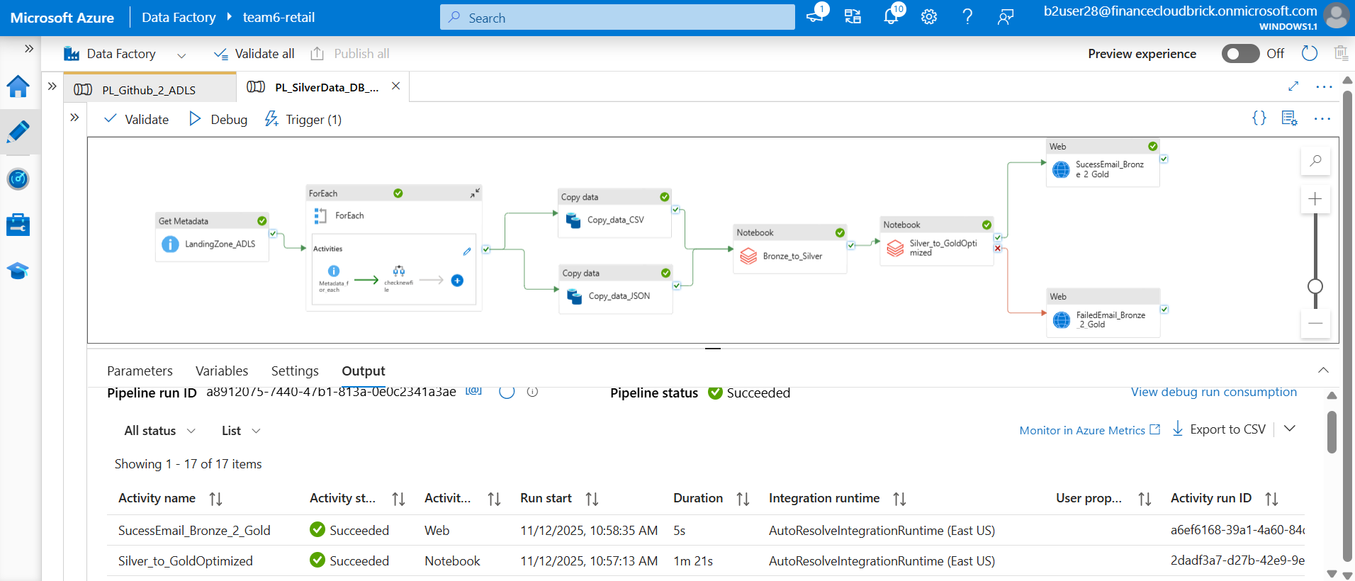
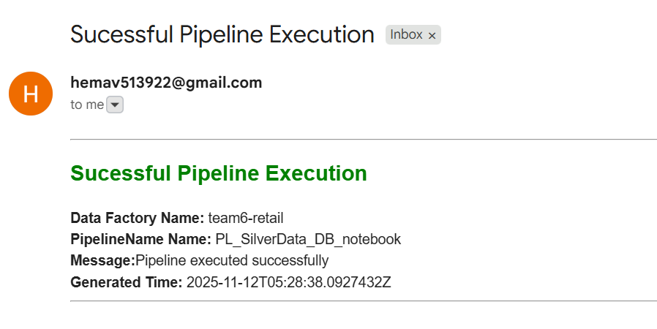
ADF Pipeline Automation ( Bronze -> Silver -> Gold)

Slide 7
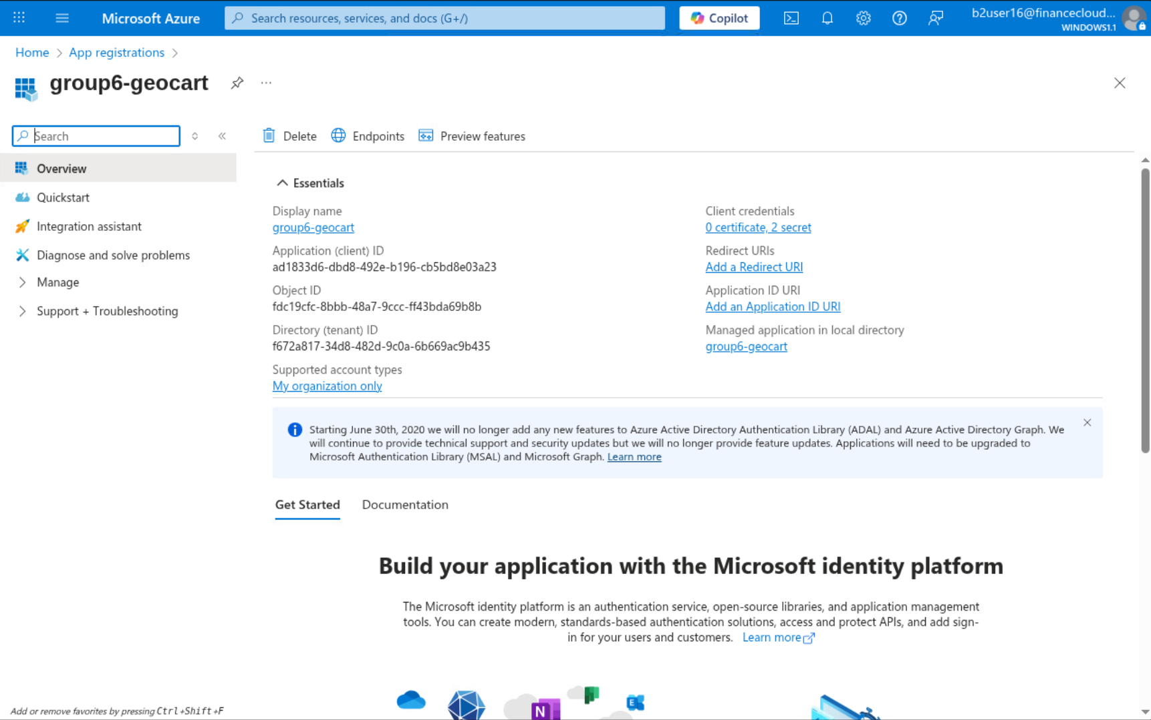
App Registration
Created an App Registration in Entra ID to enable secure authentication and authorization for Databricks to access ADLS.
Configured Client credentials (Client ID, Tenant ID, and Client Secret) for the registered application.

Slide 8
Data Cleaning
Common Cleaning Steps:
Replaced blank or invalid values with NULL
Standardized date formats (e.g., yyyy-MM-dd).
Applied text formatting using trim(), initcap(), and lower() for uniformity.
Removed duplicates to maintain uniqueness and schema integrity.
Ensured proper data types (Integer, Double, String, Boolean).
Numeric Data Handling:
Extracted valid numeric values from mixed fields.
Handled missing or invalid entries using calculated or default values.
Applied outlier capping using percentile (1%–99%) thresholds.
Data Privacy & Masking:
Masked sensitive personal identifiers such as emails and phone numbers.
Email → j*****e@domain.com
Phone → XXXXXXXX45
Ensured all sensitive attributes comply with privacy and compliance standards.

Slide 9
Data Optimization
Query & Join Optimization:
Applied column pruning to read only necessary attributes.
Used repartitioning on key columns (CustomerID, ProductID, RegionID) for better data locality.
Implemented broadcast joins for dimension tables to reduce shuffle and speed up FACT–DIM merges.
Performance Enhancements:
Cached the final DataFrame to improve repeated query performance.
Ran validation queries (before & after caching) to compare execution times.
Coalesced output files for efficient storage and reduced metadata load.
Partitioned GOLD data by Year and Month to improve query pruning in analytics.

Slide 10
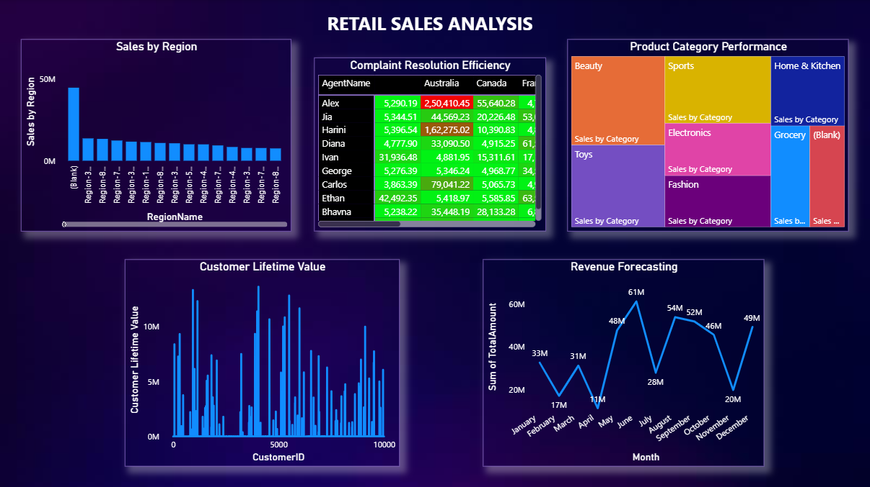
Visualization

Slide 11
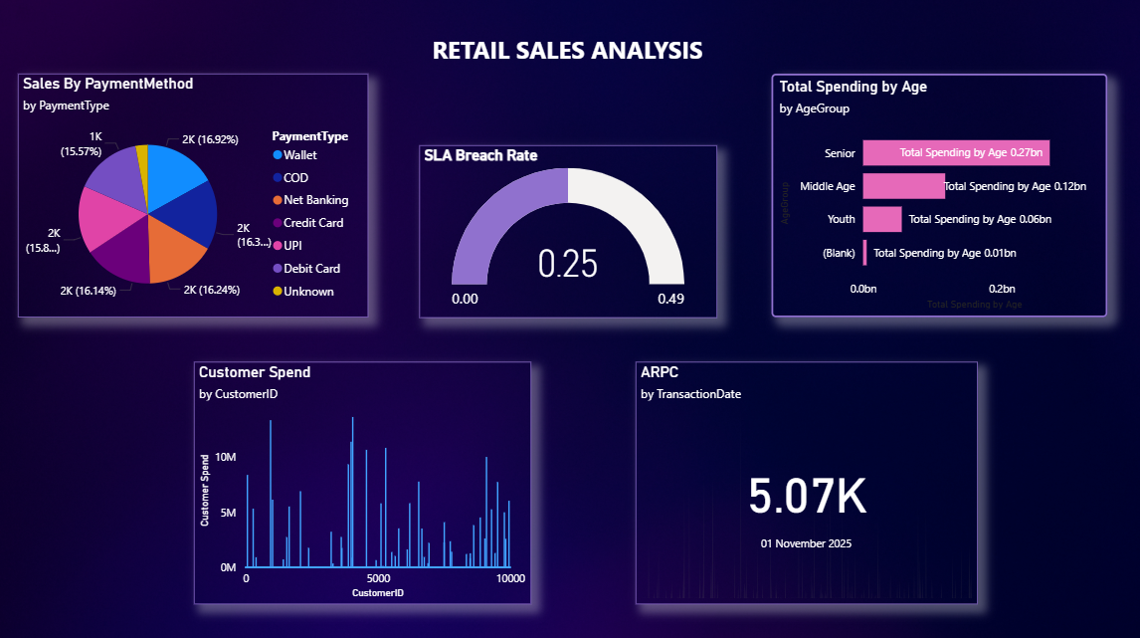
Visualization

Slide 12
Challenges
Challenge 1: Data Ingestion
Issue: Manual upload from local system.
Solution: Use GitHub → ADLS ingestion via ADF with incremental loading for automation and version control.
Challenge 2: Databricks Connection with ADLS
Issue: Couldn’t mount ADLS in Databricks due to permission issues.
Solution: Implemented Service Principal authentication and create Azure Key Vault scope for secure access.
Challenge 3: Performance Bottlenecks
Issue: Slow processing and scalability concerns.
Solution: Apply optimization techniques like partitioning and parallelism in Databricks.

Slide 13
Conclusion & Future Scope
Moved everything to cloud for better scalability and performance.
Medallion Architecture with ADF & Databricks Integration:
Bronze Layer: ADF Data from GitHub repository to ADLS as raw data. Silver Layer: ADF triggers the Databricks EDA notebook for data cleansing and structuring, storing transformed data in ADLS as staged data. Gold Layer: Databricks notebooks extract Silver layer data and execute additional notebooks for business insights
Pipeline for Coordinated Execution: Built a structured pipeline to orchestrate and run all Databricks notebooks efficiently, ensuring smooth data flow and processing.
Power BI Integration: Linked Gold-layer data to Power BI, enabling dynamic dashboards for business insights.
Future Scope:
Integrate Azure Event Hubs for streaming.
Add predictive analytics with Azure ML.

Slide 14
Thank You ☺

